Slide 1
Dibimbing Data Engineering Project
RFM Segmentation - Batch Processing
Muhamad Ivan
Data Engineering Batch V

Slide 2



Education:
Universitas Trisakti
Master Management Marketing (2021-2023)
Hacktiv8
Bootcamp Data Scientist batch 13 (2014-2019)
Muhamad Ivan
Institut Tekonologi Bandung
Environmental Engineering (2014-2019)
Self Overview:
Data analyst worked at Fintech with 2 years of experience in interpreting data in growing start up, and providing suggestion to boost business revenues in financial technology companies in Indonesia.
Working Experience:
Data Analyst
at Transfez (2022-present)
LinkedIn:
https://www.linkedin.com/in/mivanivan/
HSE Staff
PT Seiwa Indonesia (2019-2022)

Slide 3
Overview Project
Transfez Analysis:
Discovering consumer transaction behavior towards seasonal patterns and destination country currencies so that marketing can anticipate low season transactions and take advantage of consumer behavior during high seasons.
Create an analysis of consumer alive probability for each of the consumer. This analysis can help CRM to identify potential churn customers so that preventive measures can be taken
Determine which customers to target for marketing campaigns using techniques like RFM analysis (scoring, segmentation, predictive model).
Discovering AHA Moment in consumer product in order to improve user retention.
Hacktiv8 Project:
Handwritten Signature Forgery Detection using Computer Vision & Cosine Similarity
Gender Prediction based on close-up photos Using Convolutional Neural Network (CNN) / Computer Vision

Slide 4
Main Project

Slide 5
Project Background
RFM itself is a fairly well-known and frequent analysis method used in marketing strategies through a CRM (Customer Relationship Management) approach. RFM requires loyalty assessment not only to be seen from the amount of purchase value (monetary) carried out by the customer but also involves the level of frequency and last time (recency) a customer makes a transaction.
To maintain the quality of segmentation, maintenance needs to be carried out regularly and it is quite labor intensive if done manually and high change of human error.

Slide 6
Objective & Benefits
Objective:
Create a pipeline that can automate the segmentation process periodically
Benefits:
This pipeline will reduce human effort which has to be done manually and eliminate human error
This pipeline will help data analyst and product manager to decide which user get promotion to maintain users retention.

Slide 7
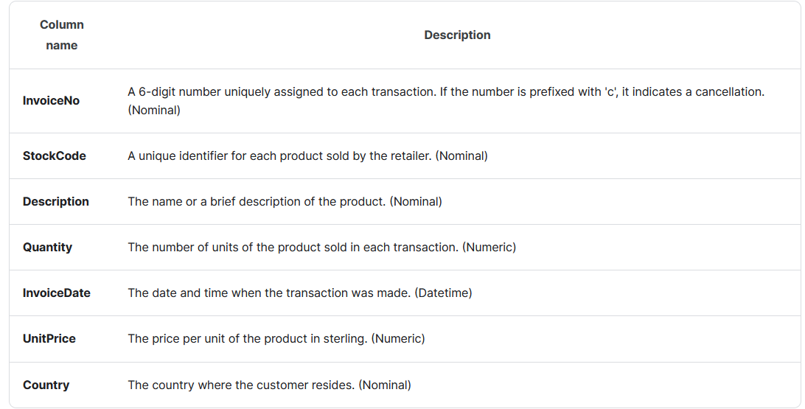
Data Understanding
Source Data: Online Retail Transaction Data (Link: Kaggle)
Data Credit:
Total Column : 7 Column
Total Row : 541,909 Row
Data Description: UK Online Retail Sales and Customer Transaction Data

Slide 8






Expected Architecture / Pipeline
Workload Orchestrator
Input Data
Processing & Transform
Data Source
Data Output

Slide 9
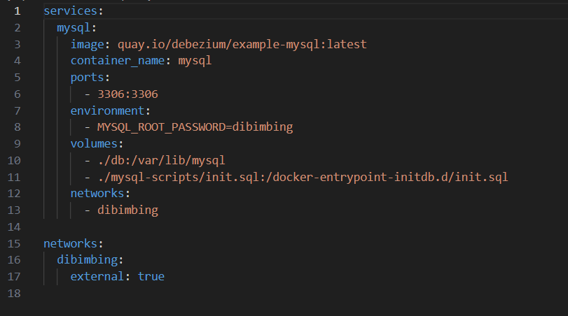
Data Pipeline – Data Source
MySQL: docker-compose.yaml

Slide 10
Data Pipeline - Processing
Airflow DAG:
File:
2_final_assignment.py
Step:
Define Airflow DAG named etl_mysql_to_mysql_2
Extract: take data from MySQL into xcom
install_dependencies: Installing necessary package such as scikit-learn
transform_data: processing data from raw data into users segmentation
load_to_mysql: load the data back to MySQL

Slide 11
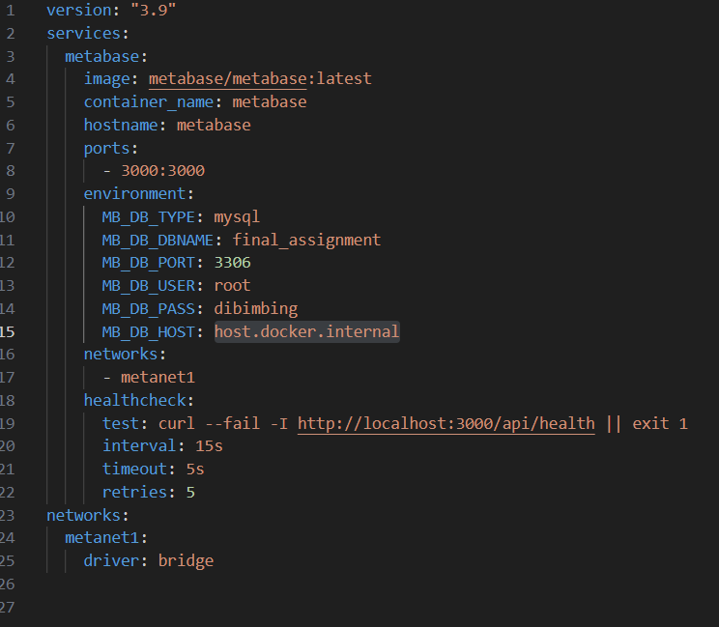
Data Pipeline - Visualization
Metabase: docker-compose.yaml

Slide 12
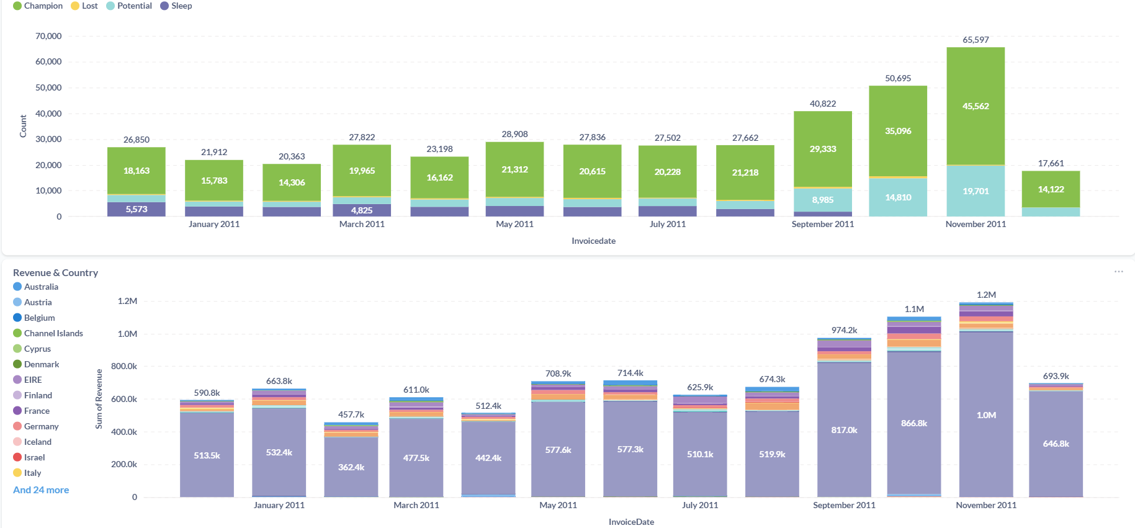
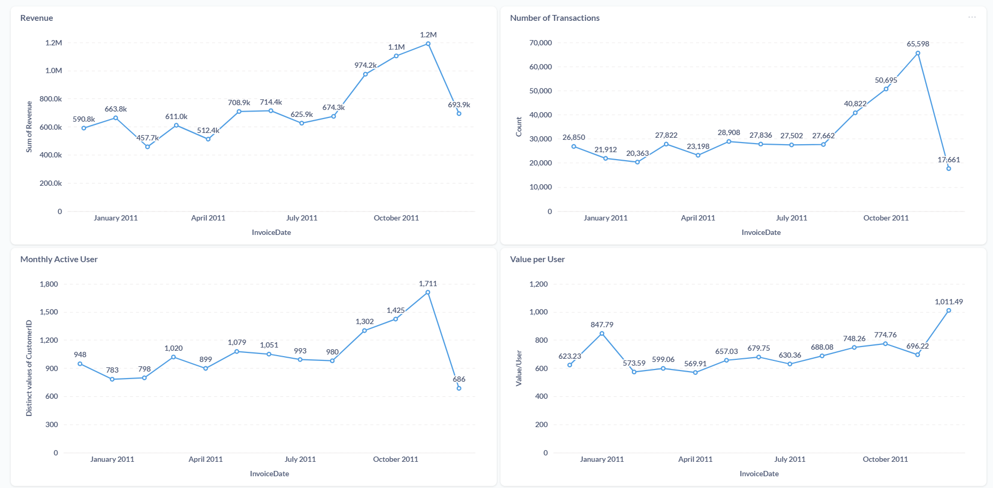
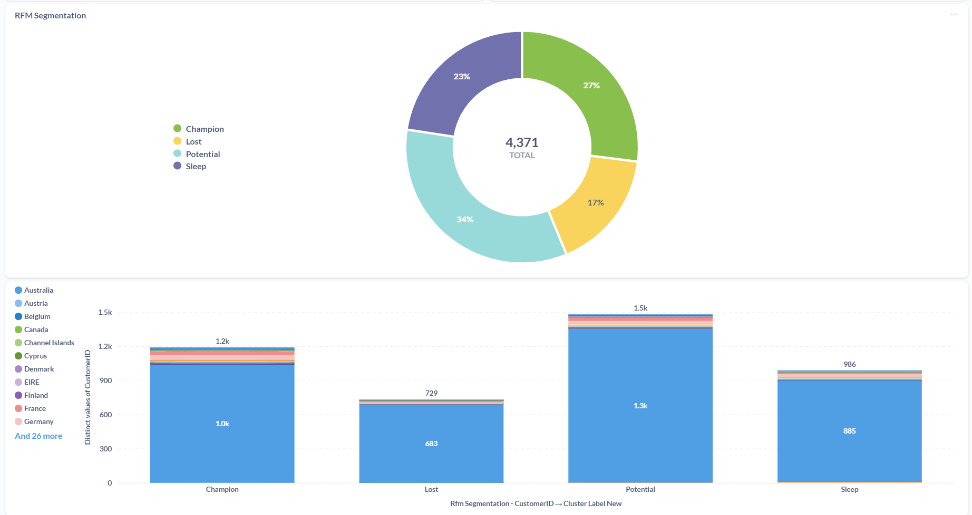
Data Output

Slide 13
THANK YOU

